Slide 1
CI/CD Roadmap – TRISTAN AgS 2024 Strategic plan for seamless software delivery automation

Slide 2
Agenda
CI/CD Roadmap Overview
TRISTAN AgS 2024 CI/CD Milestone Timeline – September 30, 2025
Brickyard and Dover Platform - CI/CD Status
Monitorning the Tristan and Email alerts
Conclusion Summary: TRISTAN AgS 2024 CI/CD Delivery

Slide 3
CI/CD Roadmap Overview
Final Delivery Date: September 30, 2025
Platforms: Brickyard/Valencia (Ready), Dover (Ready), Donnington (In progress)
Branch Transition: main(TOT) → Tristan development
CI/CD Scope: Repo setup, Code Review, PR Triggers, Build Pipeline, Signing, Email Alerts, Sanity Tests, Continuous Delivery

Slide 4
TRISTAN AgS 2024 CI/CD Milestone Timeline – September 2025
Week | Dates | Milestone | Details | Status
Week 1 | Sep 1–5 | CI/CD Planning & Repo Setup | Finalize repo structure, permissions, and branching strategy | Completed
Week 2 | Sep 8–12 | PR Workflow & Code Review Setup | Enable PR-based triggers, enforce code review policies | Completed
Week 3 | Sep 15–19 | Build Pipeline & Signing | Implement build pipeline, integrate signing in staging | Completed
Week 4 | Sep 22–26 | Sanity Tests & Email Alerts | Add automated sanity tests, configure email notifications | Completed
Final Week | Sep 29–30 | Tristan Branch Merge & Final Delivery | Replace main (TOT) → Tristan dev, validate CI/CD across all platforms | In progress

Slide 5
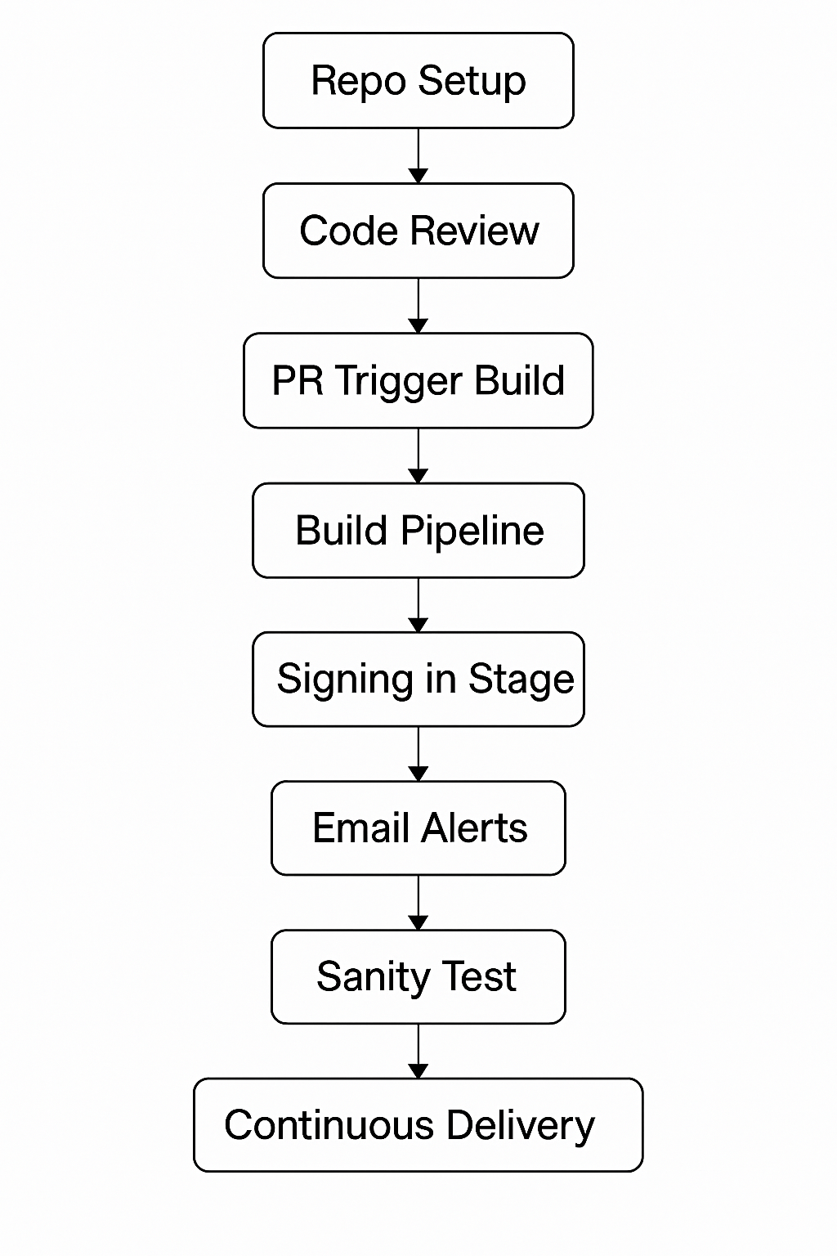
Brickyard/Dover Platform - CI/CD Status
CI/CD Readiness: Ready
✅ Implemented Components:
- Repo Setup
- Code Review
- PR Trigger Build
- Build Pipeline
- Signing in Stage
- Email Alerts
- Sanity Test
- Continuous Delivery

Slide 6

Monitorning the Tristan and Email alerts
Metrics Collection with Prometheus
Prometheus collects detailed metrics from Jenkins pipelines and infrastructure, enabling comprehensive monitoring.
Data Visualization Using Grafana
Grafana visualizes collected metrics with customizable dashboards for real-time insights and tracking key indicators.
Improved Monitoring and Notifications
Integration supports alerts and notifications for pipeline status, enhancing transparency and reducing downtime.
Notes:
Integrating Prometheus and Grafana with Jenkins pipelines provides a robust solution for monitoring and visualizing pipeline performance and infrastructure health. Prometheus acts as a powerful metrics collection tool, scraping data from Jenkins and related infrastructure components. Grafana, in turn, visualizes this data through customizable dashboards, enabling teams to gain real-time insights into pipeline execution and system status. The integration begins by configuring Prometheus to collect metrics from Jenkins using plugins or exporters. These metrics include pipeline execution times, success/failure rates, and resource usage. Grafana then connects to Prometheus as a data source and uses queries to display these metrics in an intuitive format. Dashboards are created to track key performance indicators such as Jenkins pipeline status, infrastructure health, and node availability. These dashboards help DevOps teams quickly identify bottlenecks, failures, or resource constraints. Additionally, Jenkins can be configured to send pipeline status notifications to end users, ensuring transparency and timely updates. This can be achieved using plugins that trigger alerts based on pipeline outcomes, which are then sent via email or integrated messaging platforms. Overall, this integration enhances observability, reduces downtime, and improves the efficiency of CI/CD workflows by providing actionable insights and automated notifications.

Slide 7
Demo links
Bitbucket url:
https://git.cpg.dell.com/projects/CDC/repos/ags_2024/browse
Jenkins CICD url:
https://dcb.mcsgdevops.dell.com/view/AgS2024_CI/
Grafana Dashboard:
http://100.105.92.68:443/dashboards

Slide 8
Conclusion Summary: TRISTAN AgS 2024 CI/CD Delivery
The CI/CD implementation for BIOS AgS 2024 is nearing completion, with Brickyard and Dover platforms finalized. Major milestones—such as repository setup, PR workflows, build pipeline, image signing, sanity tests, and alerting—have been successfully executed. Final delivery is planned for September 30, 2025,

Slide 9
Next Steps – TRISTAN AgS 2024 CI/CD Enhancements
Migrate the complete Tristan use case from Jenkins to GitHub Actions
Implement CI/CD for Tristan bundle: EC, BIOS, and cDRAC
Integrate with Black Duck and Coverity for security and static analysis
Develop an automation framework for security enhancements
Explore AI-driven approaches to optimize CI/CD workflows

